Slide 1
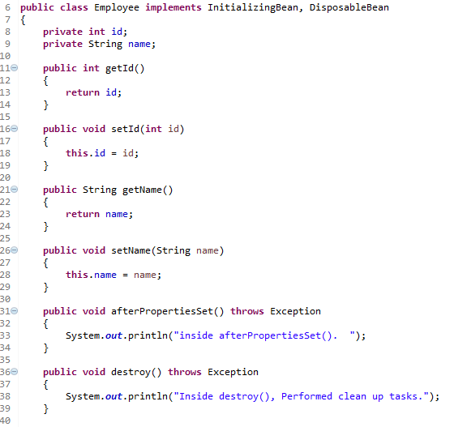
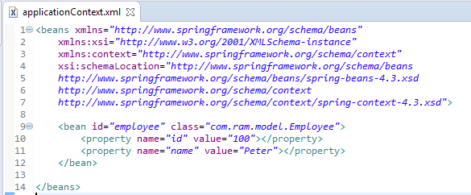

Spring InitializingBean and DisposableBean
In Spring, InitializingBean and DisposableBean are two marker interfaces, a useful way for Spring to perform certain actions upon bean initialization and destruction.
For bean implemented InitializingBean, it will run afterPropertiesSet() after all bean properties have been set.
For bean implemented DisposableBean, it will run destroy() after Spring container is released the bean.

Slide 2
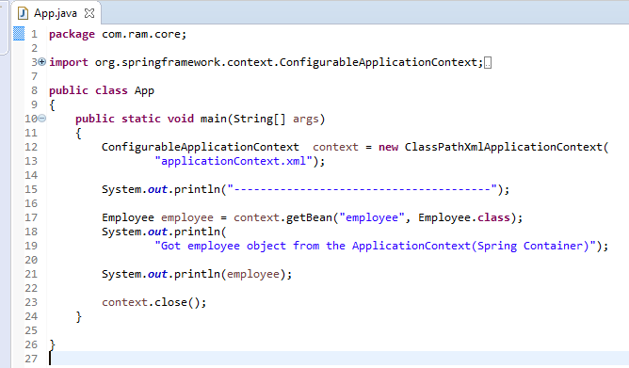
Spring InitializingBean and DisposableBean
The ConfigurableApplicationContext.close()will close the application context, releasing all resources and destroying all cached singleton beans.

Slide 3
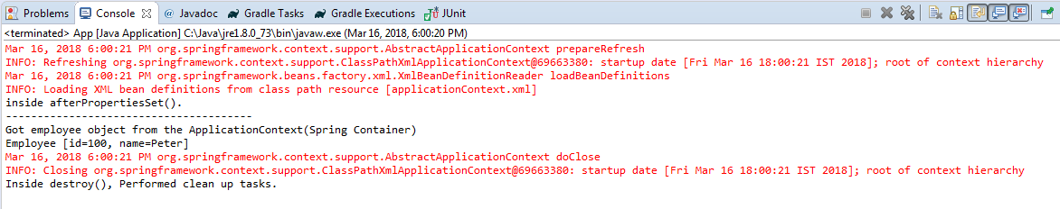
Spring InitializingBean and DisposableBean
The afterPropertiesSet() method is called, after the id and name property is set.
The destroy() method is called after the context.close();
Better not to use InitializingBean and DisposableBean interface, because it will tight coupled your code to Spring.
A better approach should be specifying the init-method and destroy-method attributes in your bean configuration file.

